Slide 1

DESIGN AND IMPLEMENTATION OF SMART WASTE BIN AND MONITORING SYSTEM USING INTERNET OF THINGS AND MACHINE LEARNING
Chairperson:
Dr. Attaphongse Taparugssanagorn
Committer Members
Dr. Chaklam Silpasuwanchai
Dr.Chantri Polprasert
Student
Tun Aung Wai
st121774

Slide 2
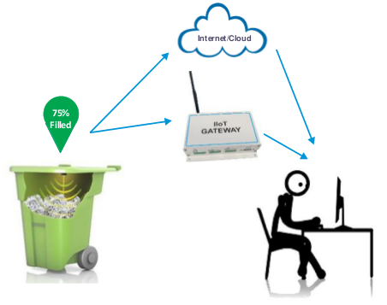
INTRODUCTION
Challenges in Conventional Waste Management
Inaccuracy in Waste Sorting: Manual, labor-intensive, error-prone processes.
Labor and Cost Intensiveness: High efforts and costs, especially in urban areas.
Lack of Timely Data: Absence of real-time data gathering and analysis.
Environmental Impact: Pollution, greenhouse gas emissions, habitat damage.
Need for Sustainable Solutions: Demand for innovative, efficient methods.
Advantages of Smart Waste Management System
Enhanced Accuracy in Waste Sorting: Achieving greater purity and efficiency.
Reduced Labor and Transportation Costs: Streamlining operation and minimizing expenses.
Improved Data Availability: Facilitating better decision-making and operational optimization.
Better Environmental Performance: Contributing to sustainable waste management practices.
Notes:
Hello everyone. Last time we talked about the problems with old waste management systems. They have many issues, like being too costly and not good for the environment.
Today, let's talk about Smart Waste Management Systems, or SWMS. These are much better because:
They sort waste more accurately.
They cost less in terms of money and effort.
They give us useful information to make better decisions.
They are better for our environment.

Slide 3
Gaps in Current Smart Bin Designs and related papers
Unnecessary Components: Increase in cost and power usage.
Lack of Scalability: Difficulty in expanding the system.
Complex Implementation: Challenges in practical deployment.
Limited Functionality: Systems focusing only on monitoring or basic features.
High Cost in Advanced Systems: Expense associated with bins capable of waste sorting.
Notes:
"Let’s talk about some smart bins that are already out there. I looked at a lot of papers and found some problems with these bins.
First, some of them use parts that aren't needed. This makes them cost more and use more power. Also, many of these bins are hard to add more of them to the system. This is called scalability, and it's important if you want lots of bins working together.
Some of these bins are also hard to start using. They are not easy to set up. And many of them only do one or two things, like just watching how full they get or opening when someone comes near.
Even the bins that can sort waste by themselves are not perfect. They do a cool job, but they are very expensive.
So, we thought, why not make a bin that’s better? We want a bin that can tell how full it is, send messages when it needs to be emptied, and even sort out the trash. And we want to do all this in a way that doesn’t use much power or cost a lot of money. We also want it to be easy for people to use.
Let's see how we made this happen in our project."

Slide 4
OBJECTIVE
01
Effective training and deployment methods for ML models in smart bins.
Optimize Machine Learning For Microcontrollers
02
Economical in cost and energy, maintaining key functions like waste identification and notifications.
Cost-Effective, Low-power Smart Bin Design
03
Immediate alerts about levels and battery life
Instant Notification Capabilities
Notes:
"Let’s talk about what we aimed to do in our study. We had four main goals:
First, we wanted to make machine learning work really well on small computers like microcontrollers. This means finding the best ways to train and use ML models in our smart bin system.
Second, our goal was to make a smart bin that doesn’t cost too much or use a lot of power. But we still wanted it to do important things like tell what kind of waste is inside and send alerts.
Third, we wanted our bin to be able to send messages right away. This way, we know when it’s almost full or when the battery is low and needs attention.
And fourth, we tried to make a part of the bin that can sort the trash. We started by using something called a servo motor. The way it sorts depends on what the ML model tells it about the trash.
These were our main goals. They guided all the work we did on this project."

Slide 5
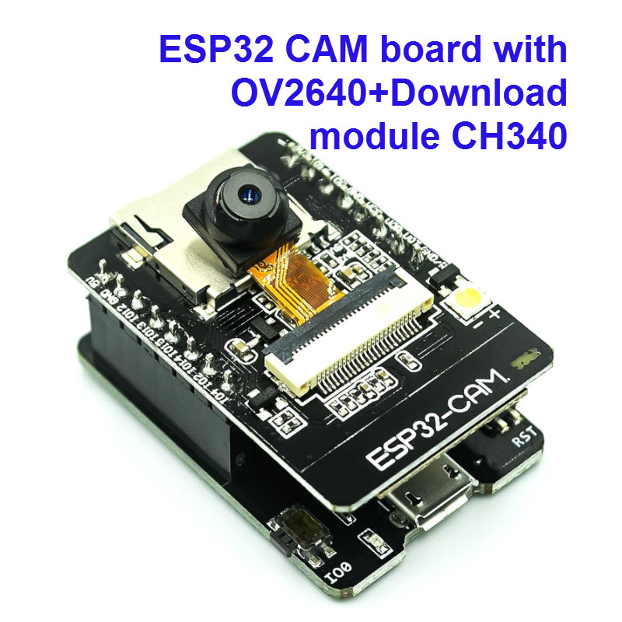
Selecting ESP32 CAM OV2640:
Cost and Efficiency
Unnecessary Components: Increase in cost and power usage.
Lack of Scalability: Difficulty in expanding the system.
Complex Implementation: Challenges in practical deployment.
Limited Functionality: Systems focusing only on monitoring or basic features.
High Cost in Advanced Systems: Expense associated with bins capable of waste sorting.
Notes:
In our proposal, we talked about using the ResNet-50 model for classifying waste. But, we found a challenge in putting this big model into small devices like our ESP32 CAM.
We chose the ESP32 CAM OV2640 for our project. It's a good choice because it costs less and uses less power compared to other setups like Raspberry Pi and Pi Camera, as mentioned in a study by Alam et al. in 2020.
The OV2640 has less memory, so it can't handle big models like ResNet-50. This was our big challenge. Other projects use Raspberry Pi for sorting waste and ESP32 for sending data. This setup is more expensive and uses more power.
We wanted to use only the ESP32 CAM for both sorting the waste and sending data. This keeps the cost and power use down. But how do we fit a good model into the ESP32 CAM's small memory? That was what we needed to figure out

Slide 6
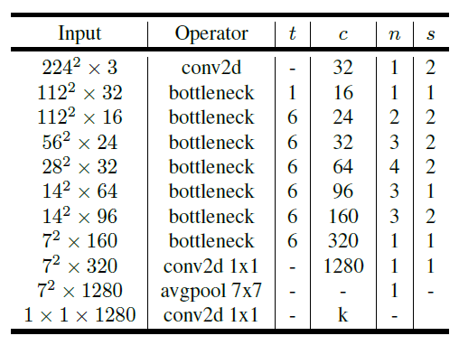
MobileNetV2: Lightweight yet Powerful
Lightweight Architecture: Designed for mobile and edge devices.
Inverted Residuals: Streamlined information flow with expansion and compression via 1x1 convolutions.
Linear Bottlenecks: Preserves important features without non-linear activation in low dimensions.
Depthwise Separable Convolutions: Reduces parameters and computational cost, maintaining performance.
Alpha (Width Multiplier): Scales the network to balance efficiency with accuracy.
Tailored for Edge Devices: Perfect for applications with limited resources, like the ESP32 CAM.
Notes:
MobileNetV2 is a neural network made for small and smart devices, just like our ESP32 CAM. It’s built to be fast and efficient without giving up its ability to make smart decisions.
The architecture uses something called inverted residuals with linear bottlenecks. Here’s how it works: It takes the input and makes it bigger with more channels, then it filters these channels without mixing them up — this is the depthwise part. After that, it shrinks the channels back down. This way, we keep only the most important information at every step.
And the bottlenecks are linear, which means we don’t lose small but important details after filtering. This is great because we want to keep as much information as possible without using too much power or space.
Now, the depthwise separable convolutions are the heart of MobileNetV2. They split a big job into smaller parts, making it less heavy on the device. It’s like having a team where each person does one task really well instead of one person doing everything.
With alpha, the width multiplier, we can squeeze or stretch our model. Think of it like a rubber band. If we pull it too much, it might snap, losing accuracy. But if we don’t pull enough, it won’t fit into our small ESP32 CAM. So we adjust alpha to get it just right.
By tweaking MobileNetV2 for our smart bin, we made it really good at knowing different types of trash, even in different lighting or positions. This is key for making sure our smart bin sorts waste correctly.
So, we’ve got a model that’s just the right size, works fast, and still knows its trash — that’s why MobileNetV2 is our top choice."

Slide 7
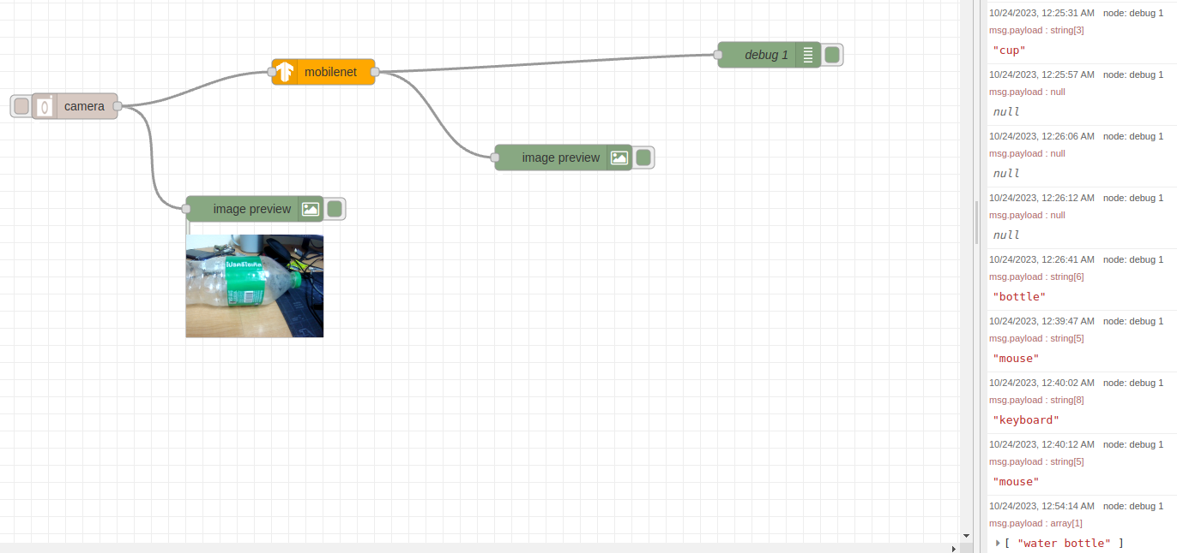
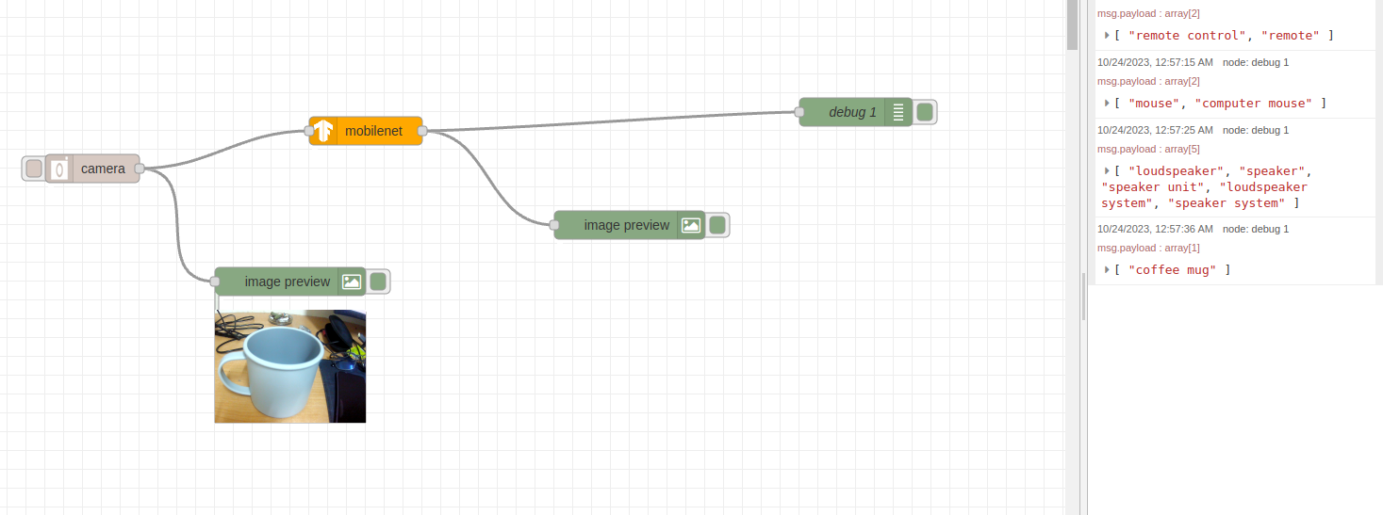
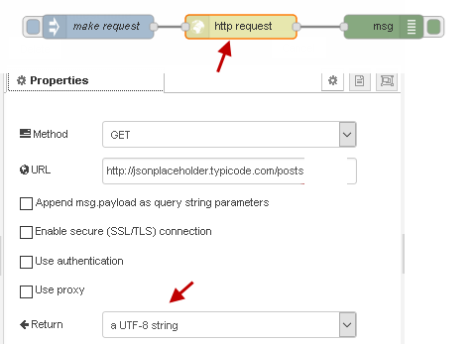
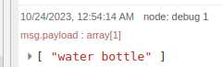
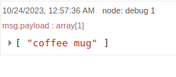
Initial Trials with Node-RED and MobileNet
Rapid Prototyping with Pre-built Nodes: Leveraging MobileNet Node in Node-RED for out-of-the-box image classification.
Workflow Setup: Camera node captures image → Image sent to MobileNet node → Classification displayed in Image Preview node.
Real-time Classification Performance: Highly accurate results with minimal latency observed during tests.
Generalized MobileNet Model: Pre-trained on a large dataset, recognizing a vast array of classes, e.g., 1,000+ classes from ImageNet.
Custom Model Development: Necessity to fine-tune and convert a TensorFlow model to TensorFlow.js for specific waste material classification.
Implementation Challenges: Creating a custom Node-RED node vs. API approach, both faced with complexity and response time issues.
Strategic Pivot: Shifted focus to alternative methods aligning with project goals for simplicity and real-time execution.
Notes:
"In the early stages of our project, we experimented with Node-RED, an intuitive tool for connecting devices and processes. We utilized a node that was pre-configured with the MobileNet model, which is a powerful image classification tool right out of the box.
Here's what we did: we had a camera take a picture, which was then sent to the MobileNet node within Node-RED. The result? We could see what the camera saw, labeled and categorized accurately, and it was fast – really fast. No waiting around; it was like real-time.
But here's the thing: MobileNet is a generalist. It's been trained on a huge dataset — think over a thousand different categories, like what you find in ImageNet. That's like having a dictionary when you just need a glossary.
We wanted something tailored, a model that knows about waste, not zebras and telescopes. So, we got to work on fine-tuning our own model with just the right categories and converted it into TensorFlow.js format because Node-RED, which runs on Node.js, is friendly with JavaScript.
Now, we faced a fork in the road. Should we build our own custom node in Node-RED using our model? Or should we set up an external Machine Learning API and fetch the classification over HTTP requests?
We rolled up our sleeves and tried both. Two weeks in, we hit walls. These methods, while feasible, were not smooth sailing. They introduced complexity and, more importantly, latency, which we couldn't afford.
So, what did we do? We adapted. We remembered one of our core goals: to keep things simple and efficient. We decided it was time to look for another path, one that would meet our needs for a straightforward, swift solution."

Slide 8
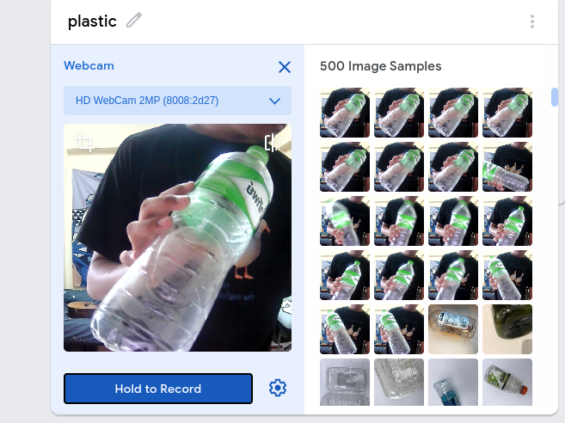
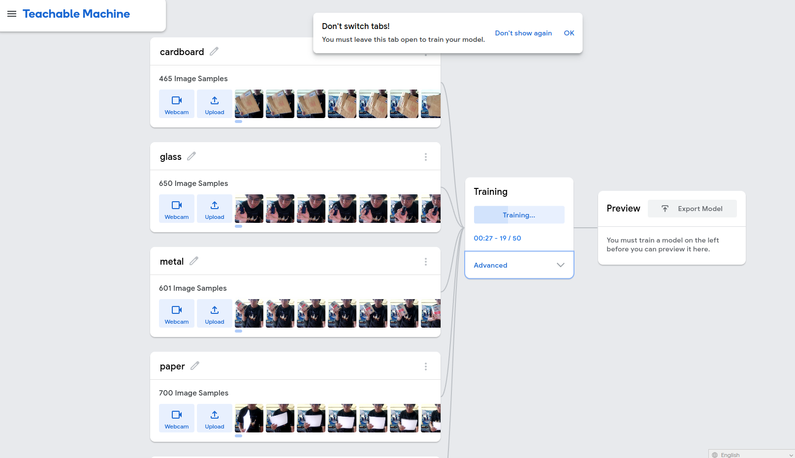
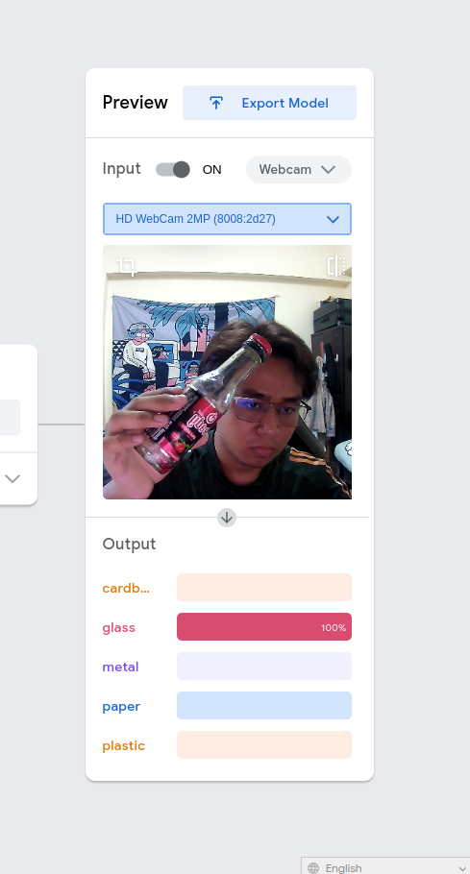
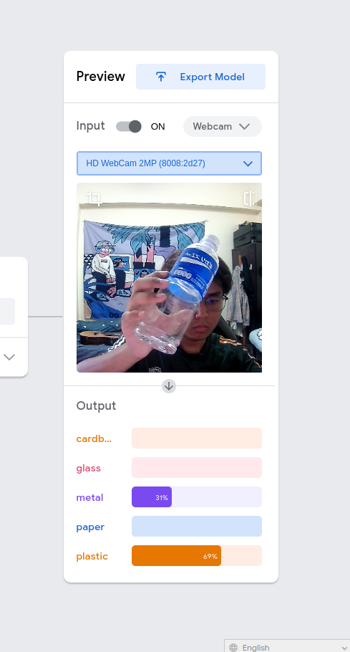
Trying Google Teachable Machine
User-Friendly: Easy to add pictures and train.
Quick Learning: Learns fast and gives good results.
Outputs: Can make models for websites or apps.
Problem: Making the API for our bin was hard.
Notes:
we also tried using something from Google called Teachable Machine. It's a tool that is very easy to use. You can put pictures into it, or even use a camera to take new ones. It learns what's in the pictures very quickly, and it does a really good job.
Teachable Machine is good for starters. It lets us make models that can work on websites and even on mobile apps. We made two kinds: one is called TensorFlow.js, and the other is TensorFlow Lite.
But we had a big problem. We needed to make a way for our smart bin to use the model we made. This is called making an API. We tried, but it was too difficult. So, we had to look for another way."

Slide 9
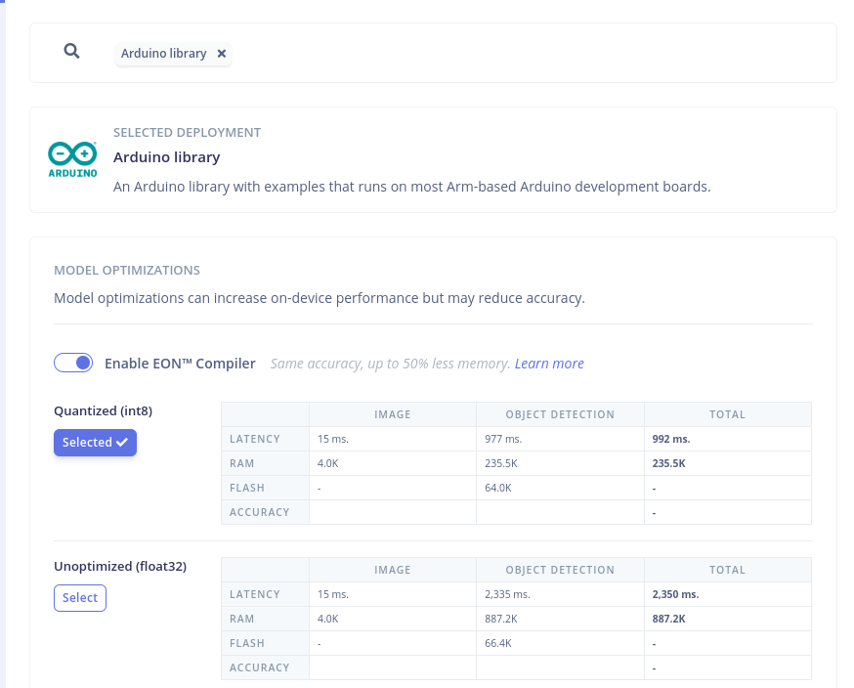
Edge Impulse:
Smart and Efficient for ESP32 CAM
What is Edge Impulse?
A tool that helps to put smart models directly into small devices like ESP32 CAM.
Fits ESP32 CAM Perfectly: Designed for devices with less power and space.
Easy to Use: User-friendly way to train and deploy models.
Direct Deployment: Puts the trained model right into the ESP32 CAM.
Suitable for Our Bin: Makes our smart bin smarter without needing extra parts or steps.
Notes:
Okay, so we found another way to make our smart bin work well. We used something called Edge Impulse. It's a tool that helps us to put our smart model right into small devices, like our ESP32 CAM.
Edge Impulse is great for devices that don't have a lot of power or space. It's just right for our ESP32 CAM. The best part is, it's not hard to use. We could train our model and then put it directly onto the ESP32 CAM. This means we didn't need any extra stuff or complicated steps.
This was really good for our project. With Edge Impulse, we made our smart bin able to know what kind of trash it has, all by itself, without needing to send pictures anywhere else or ask another computer. It's like teaching the bin to be smart on its own."
This slide and script present Edge Impulse as a solution that simplifies and streamlines the process of deploying a machine learning model directly to ESP32 CAM, emphasizing its suitability and ease of use for your smart bin project. The language is kept simple and easy to understand.
we can choose how to make our model. One way is called quantized, which means it uses less memory. This is good because it keeps things simple and fast. The other way is unoptimized, which uses a bit more memory but can be more detailed.

Slide 10
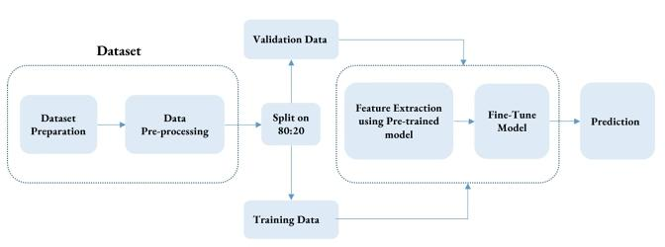
Training Process for Waste Classification
Collect Data: Gather trash images from datasets like Trashnet and Trashbox.
Prepare Data: Organize and clean up the images to make them ready for training.
Split Data: Divide the images into two groups: one for training the model and one for validating its accuracy.
Extract Features: Use a pre-trained model to understand and learn from the training images.
Fine-Tune Model: Adjust the pre-trained model specifically for our types of trash.
Validate Model: Test the model with the validation group to see how well it can identify trash types.
Ref: Trash Detection and Classification using Quantum Transfer Learning (https://ieeexplore.ieee.org/document/9770922)
Notes:
when we trained with trashnet dataset, the accuracy is not good. https://ieeexplore.ieee.org/document/9770922 In this paper, the authors solved that problem, they collected data for this specific problem. They named the dataset as trashbox

Slide 11
TrashNet Dataset
Class | Training Data | Validation Data
Cardboard | 239 | 82
Glass | 405 | 102
Metal | 36 | 92
Paper | 477 | 123
Plastic | 398 | 98
TrashBox Dataset
Class | Training Data | Validation Data
Cardboard | 1501 | 379
Glass | 1934 | 366
Metal | 1650 | 415
Paper | 1731 | 437
Plastic | 1784 | 425
Medical | 1265 | 300
E-waste | 1934 | 482
Custom Dataset
Class | Training Data | Validation Data
E-waste | 61 | 19
Glass | 65 | 17
Plastic | 82 | 14
Paper | 47 | 14
Organic | 58 | 18

Slide 12
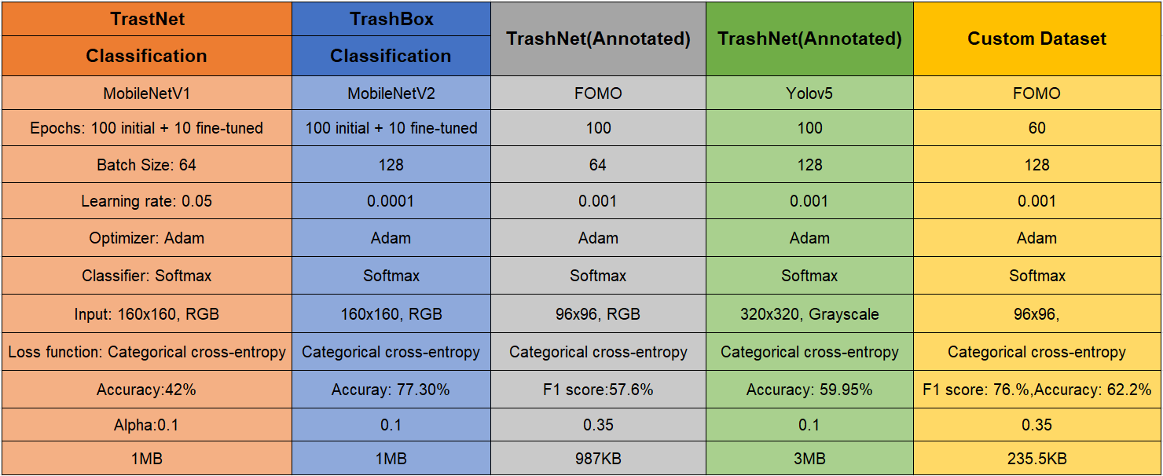
Notes:
First we trained trashnet dataset with base model mobile net V2 fined tuned. F1 score is 57.6%. The matrix showcases high classification rates for certain categories, like
’Cardboard’, yet reveals some confusion between classes such as ’Glass’ and ’Paper’. As the dataset has lesser data for metal compared to other classes, It only has 21.8% accuracy. So, we trained for trashbox dataset which has more images. The accuracy is 77.3% which is really good. But when we test, classification models are good in real time testing. so we tried object detection model.

Slide 13
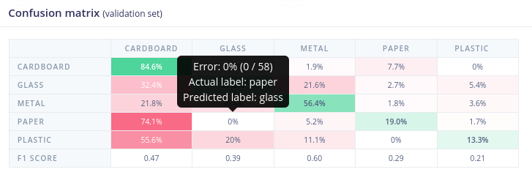
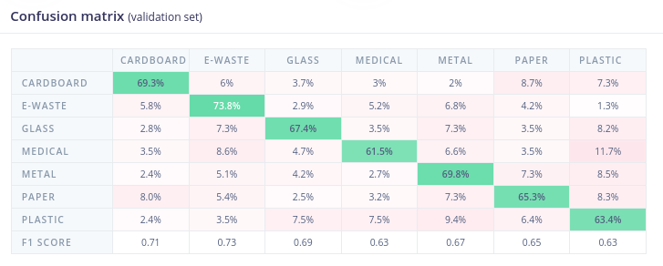
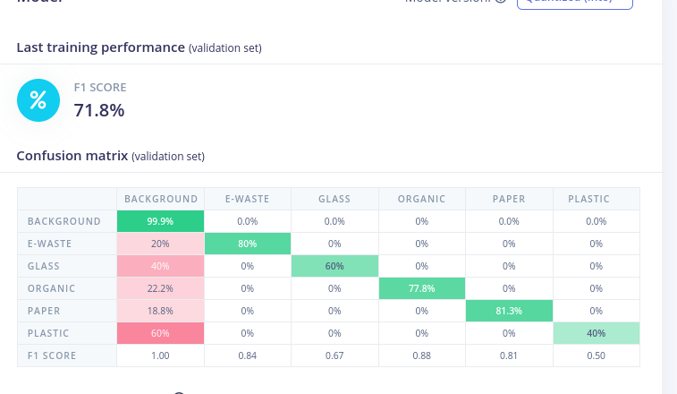
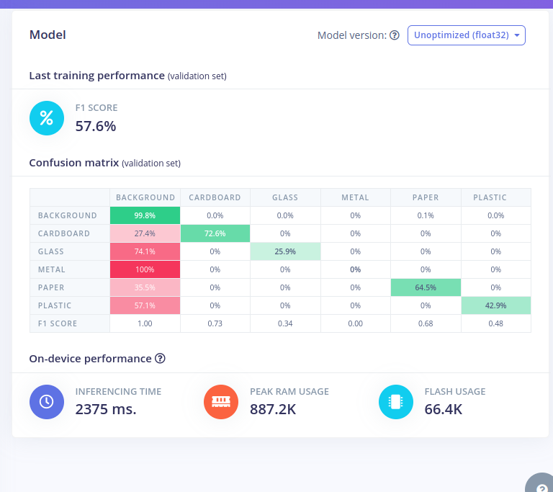
TrashNet
TrashBox
FOMO( Custom Dataset)
FOMO(TrashNet)

Slide 14
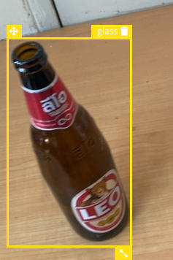
FOMO: Efficient Object Detection on Edge
What is FOMO?
A machine learning algorithm designed for devices with low resources.
Efficiency: Uses up to 30x less power and memory compared to other methods.
Functionality: Counts and locates objects, tracks multiple items in real-time.
Developed By: Edge Impulse, focusing on edge computing solutions.
Architecture:
Feature Extractor: MobileNet-based, customizable for different needs.
Classifier: Fully convolutional, efficient in categorizing objects.
Example Setup:
Input: Images of size 160x160 pixels.
Backbone: MobileNet-V2 with alpha set to 0.35 for balance between speed and accuracy.
Classifier: Default FOMO configuration with 32 dense units for binary classification.
Notes:
It is developed by edge impulse. They said it can used up tp 30x less power and memory compared to other object detection models. That is really good to deploy in micro-controllers. I have also tested Yolov5 and mobile NetV2 SSD lite. Training with FOMO singificanlly has lesser model size. While we trained with trashnet dataset that has annotated with bounding boxes and the results is not bad F1 score:57.6% but the size is not still ok. So we collected our own custom data with phone that we can connect to the edge impulse and immediately upload the photo. Then those photos are annotated with bounding boxes. Collected five classes : paper, plastic, glass, e-waste and organic.

Slide 15
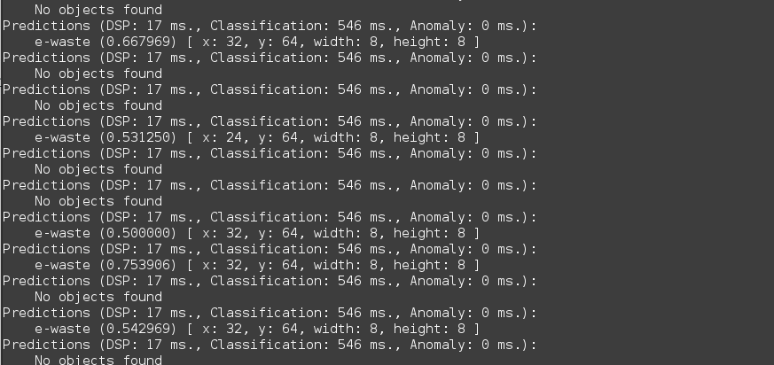
Node: video1,2,3
Notes:
So, we choosed the model trained with the custom dataset. Imported as arduino library and deployed to the ESP32 CAM. The classification results are accurate but have latency about 3 second to detected. Based on that classification results, we can make servo motor rotations to sort the waste.

Slide 16
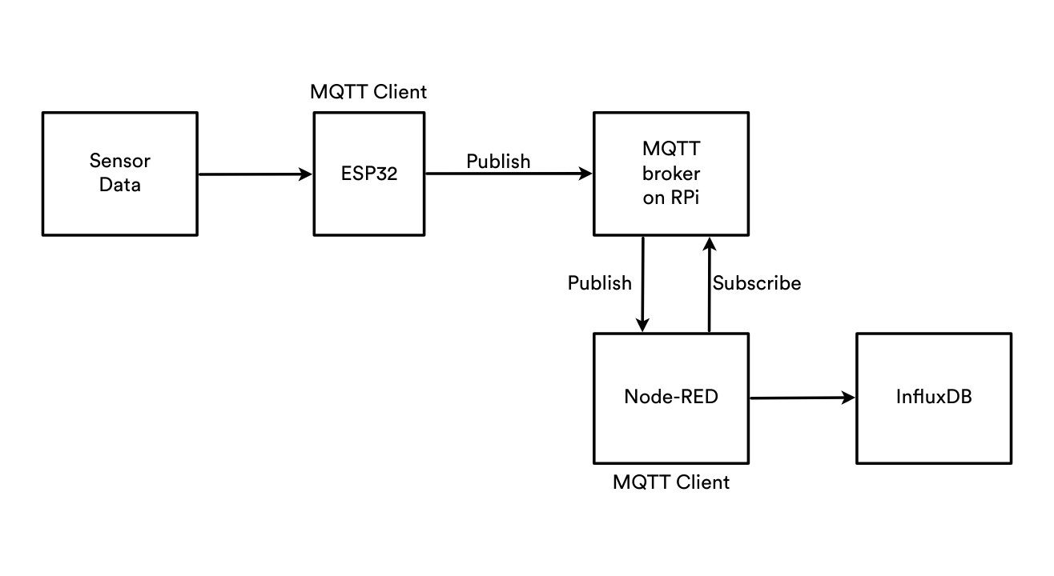
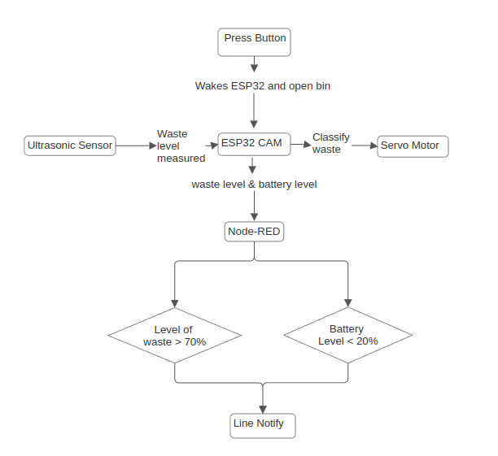
Block Diagram
FOMO( Custom Dataset)
Software Architecture
Notes:
To save power, we do not want to operate the ESP32 all the time. For this system, we do not need to send the data all the time, We will only publish data when the person is throws then ESP will goes to deep sleep mode. While there are timer wake up, touch wake up , external interrupt wake up, ULP (Ultra Low Power) Co-processor Wake Up. we used external wake up by using push button. That can later use for bin opening. When we presses push button, that will makes the servo motor rotation and bin open and also wakes up ESP32 from deep sleep mode. That why we choose external wake up mode. We used Raspberry pi to host MQTT broker and Node-RED. But for futher developments, we can use other servers. We used it for testing. By using Node-RED, we can add more bins to the systems easily while it works with publish/subscribe. We can just easily pulish for new bins for example waste/bin1 and subscribe that topic from Node-RED. When waste level is greater than 70% or battery level is lower than 20%, it will send notifications to Line personal account or groups.

Slide 17
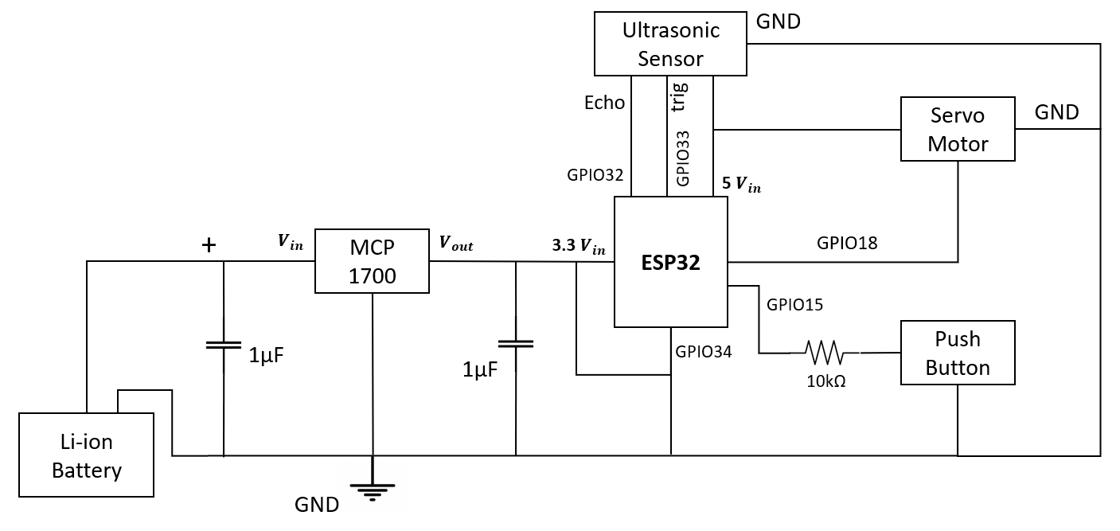
Block Diagram
Hardware Block Diagram
Notes:
This is the hardware block digram.Ultrasonic sensor ECHO is connected to GPIO32 and Trig is connected to GPIO33.VCC is connected to 5V pin and GND to GND. Servo Motor is connected to 5Vin and GPIO 18. To power the ESP32, we choosed 500mAh li-ion battery. We will discuss later how we choosed 500mAh for our system. While li-ion battery maximum voltage is 4.7V, we need to step down the voltage, while ESP32 only has one 5V pin that is already used. To connect to other Vin which is 3.3V, we need to step down the voltage. To step down, Using a voltage regulator can indeed be more power-efficient compared to a voltage divider made of resistors for powering a device like the ESP32. A voltage divider constantly draws current proportional to the voltage drop and the resistance, which can waste power, especially when the system is idle.
A voltage regulator, particularly a low-dropout (LDO) regulator, is designed to minimize the amount of electricity converted into heat when stepping down voltages. It only consumes as much power as needed by the load, making it more energy-efficient for battery-powered applications.
Capacitors are commonly used alongside voltage regulators to stabilize the output voltage and filter out any noise, further ensuring the ESP32 operates within safe voltage levels and with a clean power supply.

Slide 18
Battery Life Estimation: Data and Calculations
Power Consumption Data:
Active Current Draw: Current during operational state.
Sleep Current Draw: Current during deep sleep mode.
Active Duration & Sleep Duration: Time spent in each state.
Waste Cycles Per Day: Number of times the bin is activated.
Energy Consumption Equations:
Energy per Cycle (mAh): Active Current (mA) × Active Time (h)
Daily Energy Consumption (mAh): Energy per Cycle × Cycles per Day
Battery Life (days): Battery Capacity (mAh) / Daily Consumption (mAh)
Notes:
to estimate the ESP32 CAM's battery life started with collecting precise data on how much power it uses. We measured the current draw when it's active and when it's sleeping. We also noted how long it stays in each state and how often it wakes up to sort trash each day.
To make sense of this data, we used some straightforward equations. We calculated the energy used each time the bin wakes up and multiplies that by how many times it does this in a day. Then, to find out how long our battery would last, we divided the battery's total power by the daily usage."

Slide 19
Battery Life Estimation: Data and Calculations (Continue)
Synthetic Data Generation:
Poisson Distribution: Models average daily activations.
Uniform Distribution: Varies active current, sleep current, and durations.
RandomForestRegressor: For predicting daily energy consumption.
Sleep Time and Power Efficiency:
Sleep Time (s): 86,400 - (Wake Cycles × Active Time)
Maximizing sleep time to enhance battery life.
Training and Results:
Model trained on real and synthetic data.
Evaluated using Mean Squared Error (MSE).
Confirmed model predictions with actual data.
Notes:
we created synthetic data that mimics real-world usage. Think of it like simulating a day in the life of our smart bin. We used different statistical models to represent how often the bin would be used and the range of power it might draw.
Our RandomForestRegressor, which is a fancy tool for making predictions, was trained with this data. It helped us forecast the daily energy use of our bin.
We also paid close attention to how long our bin sleeps because more sleep means less power used. Finally, we tested our predictions against real-life data, confirming our model is on point. This whole process gives us valuable insights into making our ESP32 CAM run as long as possible on a single charge

Slide 20
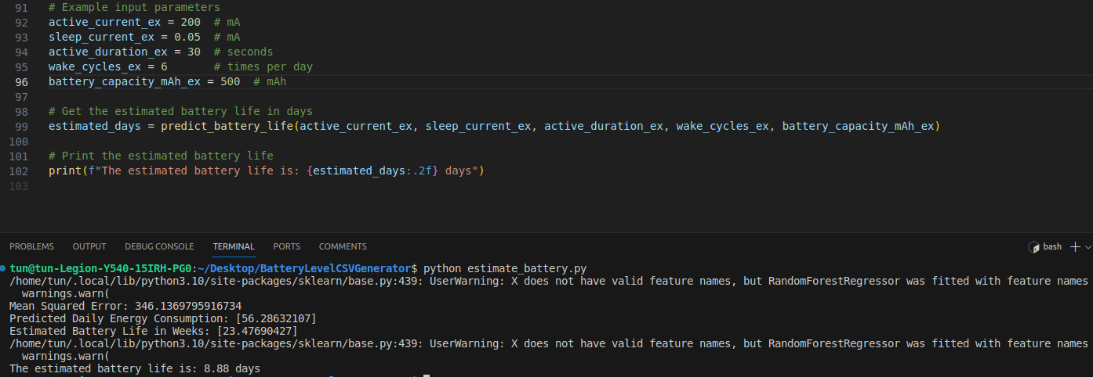
Input Parameters
Notes:
To save power, we do not want to operate the ESP32 all the time. For this system, we do not need to send the data all the time, We will only publish data when the person is throws then ESP will goes to deep sleep mode. While there are timer wake up, touch wake up , external interrupt wake up, ULP (Ultra Low Power) Co-processor Wake Up. we used external wake up by using push button. That can later use for bin opening. When we presses push button, that will makes the servo motor rotation and bin open and also wakes up ESP32 from deep sleep mode. That why we choose external wake up mode. We used Raspberry pi to host MQTT broker and Node-RED. But for futher developments, we can use other servers. We used it for testing. By using Node-RED, we can add more bins to the systems easily while it works with publish/subscribe. We can just easily pulish for new bins for example waste/bin1 and subscribe that topic from Node-RED. When waste level is greater than 70% or battery level is lower than 20%, it will send notifications to Line personal account or groups.

Slide 21
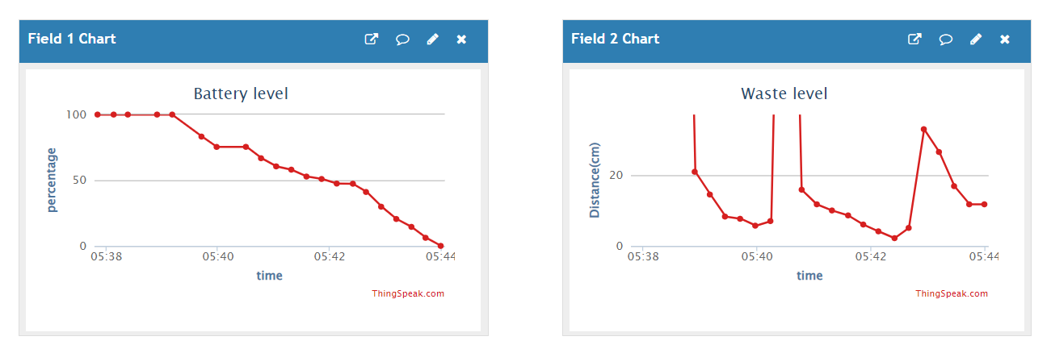
Battery Voltage Monitoring
ESP32 ADC Capability: Measures 0V to 3.3V corresponding to ADC values 0 to 4095.
Voltage Calculation
Formula: Battery Voltage = (ADC Reading × 3.3V) / 4095
Translates ADC readings to real voltage levels.
MQTT Communication
Below 3.1V: Sends "0" to MQTT topic indicating low battery.
Above 3.1V: Sends "1", signaling sufficient battery level.
Dashboard Update
Thingspeak dashboard displays the battery status in real-time.
Thingspeak Dashboard
Notes:
The ESP32's got a sharp sensor that can read voltages between 0 and 3.3 volts. This reading is then turned into a number between 0 and 4095 by the ADC, which is like a translator for voltage.
Here's the neat part: we use a simple math formula to figure out the exact battery voltage from the ADC number. When the voltage dips below 3.1V, our ESP32 sends out an alert – a zero – to our monitoring topic. And if it's all good, above 3.1V, it sends a one.
All this info gets beamed to our Thingspeak dashboard, so we can see, clear as day, if our battery is doing fine or if it needs a charge."

Slide 22
Sameless Alerts with Line Notify
Real-Time Communication: Instant alerts via Line messaging platform.
Integration Steps:
Set up Line Notify with Node-RED for outgoing messages.
Configure Node-RED to send alerts based on bin status from ESP32 CAM.
Secure link between Node-RED and Line for reliable messaging.
Benefits of Line Notify:
Wide Reach: Accessible to a broad user base for efficient communication.
Immediate Alerts: Prompt notifications allow for quick response.
Easy Setup: Simple to integrate with Node-RED, minimizing system changes.
Notes:
t, we've tapped into the power of instant messaging with Line Notify. This service lets us send real-time alerts, keeping everyone in the loop.
Here's what we did: We hooked up Line Notify to our Node-RED server, which now sends messages when the bin's full or if something's not right. We made sure this connection is secure and reliable.
Why Line? It's popular, so our alerts reach many people fast. And it's easy to integrate, so we didn't have to redo our whole system.
Now, whether the bin's full or there's an unexpected issue, Line Notify lets us know immediately. This way, we can handle waste collection and system checks without delay, keeping everything running smoothly."

Slide 23
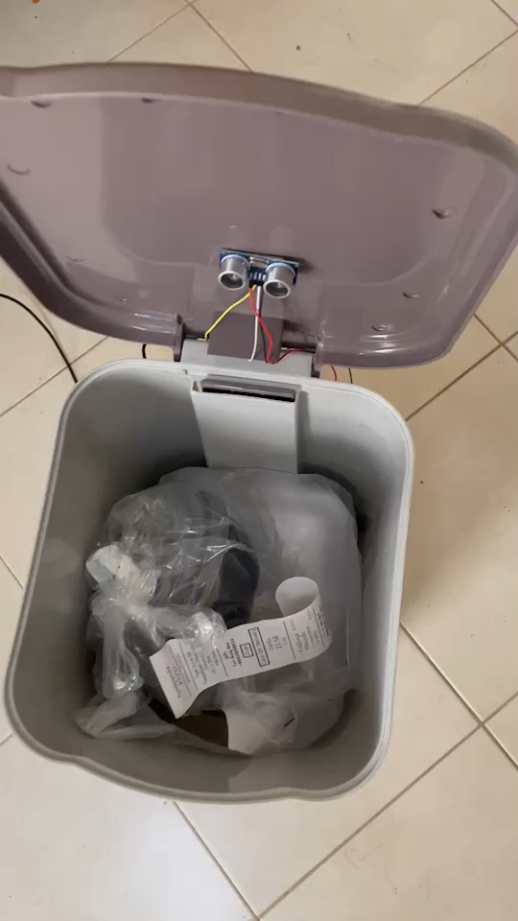
Demonstration Vedio
Notes:
t, we've tapped into the power of instant messaging with Line Notify. This service lets us send real-time alerts, keeping everyone in the loop.
Here's what we did: We hooked up Line Notify to our Node-RED server, which now sends messages when the bin's full or if something's not right. We made sure this connection is secure and reliable.
Why Line? It's popular, so our alerts reach many people fast. And it's easy to integrate, so we didn't have to redo our whole system.
Now, whether the bin's full or there's an unexpected issue, Line Notify lets us know immediately. This way, we can handle waste collection and system checks without delay, keeping everything running smoothly."

Slide 24
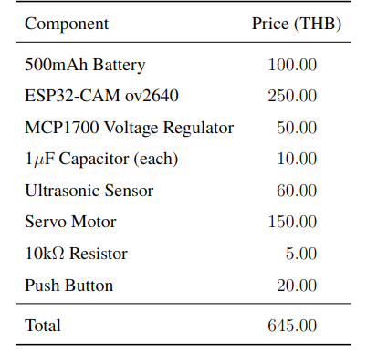
CONCLUSION
Efficient and Cost-Effective: Our smart bin is designed to be low-cost (645 THB) and low-power.
Ease of Integration: Utilizes Node-RED and LINE Notify for scalable and flexible deployment.
Innovative Classification: Use of Edge Impulse for deploying classification models.
Focus on Future Enhancements:
Improving classification accuracy.
Optimizing memory management.
Increasing detection speed.
Market Comparison: Offers similar functionalities as more expensive models in the market but at a lower cost.
Notes:
We've designed a solution that's not just efficient and easy to integrate but also incredibly cost-effective, priced at 645 THB.
Our use of Node-RED and LINE Notify ensures our system is scalable and capable of immediate alerts, crucial for timely waste management. With Edge Impulse, we've taken an innovative approach to waste classification.
Looking ahead, we aim to enhance accuracy, optimize memory usage, and speed up detection, continually pushing the boundaries of sustainable waste management.
Our design stands out in the market, offering similar functionalities to higher-priced alternatives, yet at a fraction of the cost. This project is a stepping stone towards smarter and more sustainable waste management systems."

Slide 25
Thank You For Your Attention

